Slide 1
The National Collaborative
Community Conversation Toolkit

Slide 2
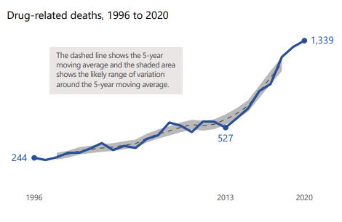
What is the National Collaborative?
The National Collaborative vision is for Human rights to be integrated into drug and alcohol policy development, implementation, monitoring, and evaluation leading to better outcomes for people affected by problem substance use.
Notes:
The First Minister has appointed Professor Alan Miller to chair the National Collaborative and bring forward the vision for how Human Rights can be integrated into drug and alcohol policy development, implementation, monitoring and evaluation.
The National Collaborative will be a network of people with lived and living experience of human rights issues relating to substance use (“rights holders”) and people responsible for delivering services “duty bearers”
Characteristics of the NC:
Inclusive: There will be more than one way for people to get involved and we want to try to build and sustain links with local community groups to ensure it is grounded in reality and able to make recommendations for practical change.
Independent: Although it is supported by an SG policy team, it is being led by Professor Miller. Angela Constance (Minister for Drug Policy) and the First Minister have agreed that the National Collaborative will act independently from the government and challenge it whenever necessary.
Action oriented: It will focus on putting human into practice.
The purpose of the NC is twofold:
To empower people affected by problem substance use to enable their voices – and, critically, their rights - to be acted upon in policy and decision-making concerning the design, delivery and regulation of drug and alcohol services at a national level.
To set out how the rights to be included in the forthcoming Human Rights Bill can be effectively operationalised so as to improve the lives of people affected by problem substance use.

Slide 3
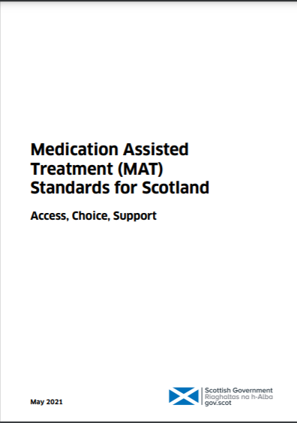
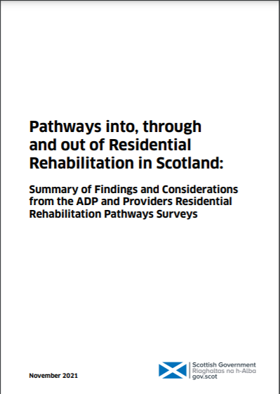
What is the strategic context?
Notes:
Talking about taking a human rights based approach to drugs is not new.
“Rights, Respect and Recovery” supported a rights-based approach to problem drug and alcohol use and committed to enabling people with lived and living experience to inform national and local policy development
Among the main focuses of the National Mission is ensuring that the voices of people with lived and living experience are heard and acted upon in decision-making to promote a human rights based approach. Many elements of the National Mission already advocate for a rights-based approach. For example the MAT Standards and Guidance on pathways into, through and from Residential Rehab.
There are also lots of existing initiatives which are led by people affected by substance use with family support groups, recovery communities, networks of drug users, peer-researchers and peer navigators and mentors all playing their part.
The National Collaborative aims to consolidate the learning from these different approaches and to facilitate a more comprehensive shift in power and change in culture.
There are a number of wider factors and potential changes affecting the drug and alcohol sector which mean that there is a real opportunity for the National Collaborative to make a difference now.
The National Care Service Bill aims to improve the quality and consistency of social care support in Scotland, including for people with addiction. It aims to change the way care is delivered, moving towards a person centred approach with stronger national oversight and accountability.
The Human Rights Bill will give effect to a range of internationally recognised human rights in Scots law. This means that people will be able to claim and enforce these rights in different ways, including in a

Slide 4
What will the National Collaborative do?
Facts
Analysis
Identification
Review
Charter of Rights
Implementation Plan
Monitoring and Evaluation Plan
Notes:
The National Collaborative will apply a Human Rights Based Approach (HRBA) and undertake a process which follows a model called FAIR. This will set out how human rights (for example the right to the highest attainable standard of health) could be practically realised.
The FAIR model (Facts, Analysis, Identification and Review) was developed by Professor Alan Miller while serving as Chair of the Scottish Human Rights Commission. It was a method used in the development of an Action Plan on Justice for Victims of Historic Abuse of Children in Care for the survivors of historic child sexual abuse to access justice.
Facts: Develop an evidence base of lived and living experience of people with or affected by problem drug use.
Analysis: co-produce an analysis of the human rights engaged in the experience of people with or affected by problem drug use.
Identification: Identify an action plan to respect, protect and fulfil the relevant human rights of people with or affected by problem drug use
Review: Review and monitor the implementation of the action plan
There will be a Change Team with responsibility for developing an ‘Action Plan’ to include:
Charter of Rights co-designed by people with lived and living experience, service providers and government. This will be based on the Human Rights Bill and will be linked to the Charter of Rights being developed as part of the National Care Service.
The Charter will be accompanied by an Implementation Framework showing how the rights (as set out in the Charter and included in the Human Rights Bill) can be realised in practice. This might include, for example, models of care; standards and workforce development; independent advocacy and a complaints procedure; monitoring and reporting and, as a last resort, access to a legal remedy.
A Monitoring and Evaluation Plan to give service providers and government a tool to support the continuous improvement of services based on a set of human rights based indicators developed through peer-research.

Slide 5
How can somebody get involved in the National Collaborative?
Network of “Critical Friends”
ADP Panels
Participatory research
Coordination and Communities Team
Reference groups online
Change Team
Notes:
We want there to be several ways for people to engage with the National Collaborative process and to avoid having “seats at the table”.
Being a “Critical friend” to the NC: People in this network will be able to offer external insight to work, often reviewing projects and offering candid feedback that may be uncomfortable or difficult to hear.
Taking part in peer-research and “Community Conversations”. To ensure the NC is shaped by the views, voices and experiences of people whose rights are affected in practice (“rights holders”) throughout.
ADP Lived and Living Experience Panels or Community Engagement Structures. These are set up to inform prioritisation, planning, implementation and monitoring of services at a local level. We want local groups to be able to feed into and influence the National Collaborative as well as the National Collaborative enabling them to grow and develop.
Member of a Reference Group: To input into the NC in an informal or ad hoc way. These groups might have a more specific focus and will either be existing groups e.g. Recovery Communities or groups which are identified as underrepresented on the Change Team. We are open to there being multiple reference groups to advice at different stages and have sent out an open invitation. Ones we already have in mind are:
Families Forum
ADP Liaison Group
Health Professional Liaison Group
International Liaison Group
Change Team to co-design an Action Plan for the National Collaborative which will include a Charter of Rights for people affected by problem substance use, as well as an Implementation Framework and Monitoring and Evaluation Framework.
The Change Team will consist of ~15-20 people, including at least 50% of people with lived and living experience and their families/ friends (“rights holders”) but also “duty bearers”- those involved in delivering services. The Change Team will meet every 4 – 6 weeks and individuals are expected to be in this role for a period of two years.
Coordination and Communities Team to guide and support people taking part in co-design, i.e. the Change Team. The Coordination & Communities Team will convene workshops, run training, support networks and connect to the community. It will also provide leadership on ongoing initiatives and projects that seek to mobilise communities of people affected by substance use. Membership may include organisations delivering services, Nationally Commissioned Organisations (NCOs), organisations employing a Human Rights Based Approach, organisations involved in advocacy or peer research.

Slide 6
DRAFT
What are the timelines?
 | 2022 |  |  |  | 2023 |  |  |  | 2024 |  |  |  | 2025
Scope & Entry
Facts
Analysis
Identification
Review
Notes:
There are 5 phases of the National Collaborative process or journey.
We are in the ‘Scope & Entry’ phase where we have been developing the Roadmap and seeking to engage with as many people with lived and living experience as possible as well as service providers, ADPs, Clinicians.
Yellow diamonds are our key Milestones
Publication of roadmap for National Collaborative (end of Summer)
Progress report from Change Team
Publication of Action Plan (including Charter of Rights, Implementation Framework, Monitoring and Evaluation Plan)
Evaluation Report monitoring progress against the objectives and outcomes of the National Collaborative (annually thereafter).

Slide 7
Time for Questions and discussion!

