Slide 1
A Crisis in Sudden Death
The need for change and a way forward
Stuart Graham 31st March 2024

Slide 2
Scotland Sudden Death Escalation In Crisis
KEY LEARNINGS/TAKEAWAYS
Scotland does not care about sudden death.
No one is accountable for improving sudden death
The crisis extends beyond drugs
FAI’s are a blindspot - a misunderstood and misleading artifact
Changing FAI’s will change little
No Substantive Learning Opportunities in Place or Taken
Where there is accountability, there is improvement - a rare find
Opportunity exists to change at relatively low cost
Recognition of family needs and involvement
A need to think differently
Increased responsiveness to change is a simple step
Notes:
This presentation essentially follows the chronological sequence of exposure I have had at looking sudden death. It is not and cannot be exhaustive. It cannot cover every worrying detail I have looked at. Hopefully it is seen for what is intended, showing the need for change and suggest a way forward that is good for everyone in our society. Unfortunately death impacts us all and we need to be assured that we learn from these tragic circumstances and thus ensure that lives are valued and not lost in vain.
I will be critical of Police and COPFS while recognising that these can be difficult jobs. Also, in the light of how severely stretched these organisations are, I would like to think with the right approach we can not only help them in their roles, we can also help build a closer association to the general public when it comes to sudden death.
This is the summary of my findings and hopefully help shape the understanding and any discussion on the upcoming information in subsequent slides. This is not the time to get into the details but really absorb the significance of what I am stating.
The primary areas of focus within the analysis in these slides show that we are seriously failing on the areas that when combined show how much contempt we have for true social justice.
If we begin to care, we can maybe actually make changes that are meaningful.
Clearly all of this is my own opinion.

Slide 3
A Fundamental Requirement
Simply put, we need a system that facilitates the potential to publicly review all sudden deaths with the aim to prevent future cases, with the families at the heart of the investigation and findings.
Notes:
The ultimate result of discussion and research points to a very simple formula for potential strides forward. These are simple words but each part highlight carries significant changes required in our society.
These are changes that most democratic 21st century facing countries already aspire to but strangely we not only fail to have the aspiration, we take great effort to stifle the conversation.
This will be backed up through this presentation.

Slide 4
Families United
Representative of Six families - Annie Borjesson, Allan Bryant Jr, John McGarrigle Sr., Barry Dixon, Stefan Sutherland and Colin Marr
(some of us have been talking for years and exposed to every aspect of Justice system for years)
Supporting input from families - Annie Davies, Kevin MacLeod and three other families (two current cases)
Common Issue - early handling failures of fatalities led to zero investigation, lives written off
Follow on issues - COPFS and Police double down on initial decision making at the expense of honesty. Despite doing no investigation they
say that their original “guess” is correct. Police even when ordered to open a homicide investigation do not do so.
Use of PIRC and Ombudsmen - Of little use. Don’t investigate actual complaint only those that police chose to investigate. only look at
what is written on files not the logic of the entry. Never comment on the fact that Police failed to admit failings in their own internal investigations.
How to make this preventable - Cause and Circumstance of death evaluated by some external body that has authority to question investigation and circumstances of death. A body with authority to set corrective actions in either situation.
Who will it benefit - Families can get closure, Police and other ES will be given greater appreciation from public, COPFS will have less work load, broader society as improvements are driven in.
Notes:
We are a group of families that have talked to each other for some time. We have developed a broad understanding of our collective views through our own question and answer sessions.
Our families have collectively been through the entire gambit of sudden death investigations, FAI’s and the entire complaints procedures and we find them appalling and they raise important questions not only of homicide but of sudden death in general.
Our families have collectively been through the entire gambit of sudden death investigations, FAI’s and the entire complaints procedures and we find them appalling and they raise important questions not only of homicide but of sudden death in general.
Our starter for looking at the management of death investigation came from our individual loss and the lack of care by authorities.
In four out of the six cases we see that the Police and COPFS lack of care removes these highly probable homicides from the records. They are moved easily into suicide suicide cases or in one a missing person.
In these cases information has either been withheld or and manipulated to the point of corrupt presentation of findings.
Media can be of great assistance but we have found that they are with you as long as “you” have new information and we believe that COPFS and Police know this and just wait everything out until the clamour has died.
Media, politicians and COPFS generally will never address the manipulation of evidence as corrupt. It seems that we would rather tolerate these aberrations than rightfully attacking and removing them. It takes individuals to speak out and fight for change while our institutions pull up the drawbridge.
We have collectively found that after families have fought for investigations, any subsequent actions taken by the authorities has the goal of doing what it takes to hide their failings rather than expose the truth. This “corruption” of fact takes place at a senior level within these organisations.
If these seriously significant deaths can be so easily written off, what about those not so obvious?
In taking this approach, it is not about fighting our cases but hopefully help others see that there is a need for change, understand what that change may be and it is not necessarily a big step but maybe the removal of a schism in our thinking.
In essence as a group of families, we would not wish our experience on anyone. It is my intention to use our stories to highlight points through this presentation.
It may also be asked why take this public approach to sharing. Well, Guje, the mother of Annie had a petition within the Scottish Parliament requesting changes to investigations and family access to information in 2010, my own family had one in 2013. Guje’s was dismissed without any serious consideration and ours was fully supported by all of the MSP’s in the petition committee but then dismissed in the Justice committee.
Despite us clearly and repeatedly stating that we were not asking or talking about more FAI’s, they decided that was what we wanted. Therefore our petition was dropped on a completely false premise. It seemed Government and COPFS responded in the context of FAI’s when this was clearly not the intent.

Slide 5
The Cultural Impact of No Accountability for Sudden deaths
Statistical Analysis and Misdirection Statistical analysis shows a deceptive portrayal of homicide rates and causes of death, masking the reality of the crisis. The implementation of the SFIU and changes in reporting practices correlate with an artificial reduction in homicide rates, raising questions about the authenticity of reported improvements. Need for Systemic Change The current structure fails to hold responsible parties accountable, resulting in a trivialization of the crisis. The low public scrutiny and delayed responses to sudden deaths underscore a system that prioritizes institutional reputation over the well-being and justice for individuals and families. Comparative Insights Looking at the practices in other countries, like England, Wales, and Ireland, reveals a stark contrast in handling sudden deaths, particularly with the more inclusive and transparent coroner's inquest system. Conclusion and Call to Action The crisis of sudden death in Scotland requires immediate attention and substantial reform. By embracing a more thorough, family-centric approach and learning from successful models in other jurisdictions, Scotland can address this crisis effectively. It’s time for Scotland to acknowledge the gravity of the situation and commit to a system that values every life and learns from every loss. This public report aims to shed light on the ongoing crisis and catalyze the necessary conversations and actions to initiate real and lasting change in Scotland’s approach to sudden deaths.
The False Sense of Success
Fail to Investigate
Improved Metrics
Incompetent Investigation
No Crime
Failure to Understand Cause
thus no learning
Corrupt Investigation
A System that rewards failure over success is designed to fail and lead to a false expectation of exceptionalism
Homicide is the only crime where prosecution define numbers - all other crimes are reported by public
Notes:
A simple profile of our findings
Understanding death in our society relies to a large part on the thoroughness of an investigation. This investigation and its integrity is the foundation of our understanding of sudden death and the driver to enable concrete actions to prevent further deaths. This the key responsibility of COPFS and is extensively managed by the SFIU (fully operational from about 2012).
It is worth noting that as a subsection of COPFS and tightly aligned to Police, they are in effect selecting their own work for prosecution. Another important note is that Pathologists in Scotland are funded by COPFS, the prosecutors. This is an important aspect of some of our later slides.
It is possible to take on the simple cases and “hide”the more complex uncertain cases within the bedrock of the other causes of death. You have to understand that homicide to day is around 60 fatalities and we have about 3000 deaths for other reasons. Ten deaths ascribed wrongly would not be noticeable if put in drugs death as an example.
By the same token, would it be feasible to shift the numbers of fatalities from one cause to another and reduce public scrutiny and condemnation? This will be explored
The most egregious issue is that at the core of good analysis is the integrity of the core data. But, in this system, it is possible to be abysmal at investigation and yet suggest that (in this case) homicide is actually dropping.
Homicide is the only real crime where the existence of the crime is decided by the “prosecutors” who would rather show no crime existed. All other crimes are generally reported as crimes by the general public.
In this instance we have the potential for seriously poor performance rewarding the organisations responsible and the perpetrator.
A striking example of this was the case of Annie Davies - as told by her son Bryan
“Annies case had 43 forensic scientists/pathologists, who attended a seminar in Belfast entitled
“An open and shut case”. All agreed Annie was killed by an intruder. Other Government officials agreed.
One solitary “expert” consulted by COPFS and Police concluded Annie had a heart attack,
based on photographs.”
This case was never re-opened
Annie’s case was pre Police Scotland but we will bring you bang up to date as we progress

Slide 6
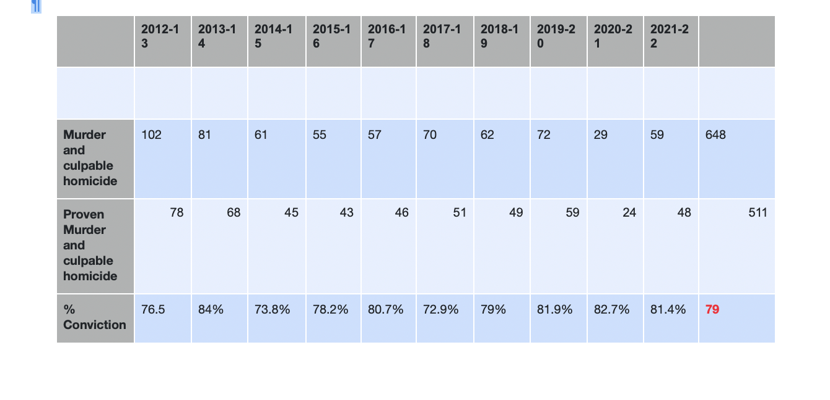
The Cultural Impact of No Accountability for Sudden deaths
The False Sense of Success
Police Scotland maintains world leading homicide detection rate
“Every homicide committed in Scotland since 2013 has been detected by Police Scotland, new figures confirmed today.
In 2022-23, all 52 homicides committed in Scotland were detected.
Latest statistics from Scottish Government, published today, show the number of homicides committed in Scotland continues to reduce.
Police Scotland’s 100 per cent homicide detection rate means that every one of the 605 murders committed since the inception of the single national
service in 2013, has been solved.”
The homicide and conviction rates per year up to 2021/22 are seen here and you can see that the sum conviction rate is 137 less than homicide cases. This is 21% less than homicide rates. If you factor in that in some cases have more than on perpetrator, there are probably more with no actual conviction.
The highest rate of acquittals for non-sexual crimes was for 13% of cases of homicide etc.
( https://www.gov.scot/publications/criminal-proceedings-scotland-2020-21/pages/7/ )
Notes:
This last comment about Annie Davies mirrors many of our groups findings but we do need to look at how homicide is being presented in society today to see the misdirection we are facing.
In this slide is that we are dealing with comments from Police Scotland that they have 100% closure on all homicide cases from the inception of Police Scotland. (Bear in mind that Annie’s case did not need a name)
How do we have 100% closure despite the fact that there is only an 80% conviction rate relative to homicides?
This seems like a very brazen self assessment of what closure means. the fact that only 80% are prosecuted must mean that some of the following are true;-
1 - Some are found not guilty
2 - Some are falsely accused
3 - Some may not have been homicide
4 - Maybe got the wrong person
All of which places greater questions on the quality of the investigation. If we can get it wrong on the ones we are certain about, what about the uncertain cases. It cannot be that credit is taken just because a named suspect is given!
These are the deaths that require significant comprehensive investigation, what does this mean for deaths that only get cursory investigations or those that get next to none.
Annie Borjersson, Colin Marr and Stefan Sutherland were all deemed to have taken their own lives with zero investigation. We will deal with aspects of their death wen we look at more specific data
Without appropriate proof/evidence , this is a very dangerous game. How far do you go to show that your initial assessment was correct rather than having an open mind to other possibilities. (In all of our cases this closed mind and hiding error is what hast taken place)
The cultural element here is that a foundation is laid down for subsequent Police chiefs. Who is going to be first say that they do not know who killed someone? What does that do to complex investigations etc? Who will say that previous assessments may have been wrong?
The cultural norm will be to maintain this phallacy.
This should all be born in mind in light of the Post Office scandal. We can get things seriously wrong but why must it be decades to recognise this??

Slide 7
Scotland Sudden Death Escalation In Crisis
Political History
In 2005 WHO stated Scotland had 2nd highest murder rate in Western Europe
2.33 deaths/100000 (England/Wales 0.7 Germany lowest at 0.68)
In 2007 we stopped publishing conviction rate for homicide as key metric
Moved to police “clear up rate” 70% to almost 100% overnight
In 2008 Pathologists views removed from drug deaths
In 2012 Scottish Fatalities Investigation Unit established
Pre 2012 there was a strong focus on violence and resulting homicides
Zero tolerance
Stop and search (Stephen House - CC Strathclyde 2007 and CC Scotland 2013)
2013 Scottish Government Suicide strategy
2013 Drug deaths starting to be noticed
(No comments accidental deaths at any time)
Notes:
Key “political” and death management significant change dates
I believe that key changes to sudden death recording coincides with very significant political timing over the last 15 years or so. Some are significant in shifting the focus of public/media attention at times when the Scottish Government needed to convince of their “management” capabilities.

Slide 8
HOMICIDE
A brief look at the Numbers
Notes:
Our focus as a group of families was the criminal aspect of sudden death and I want to start here to bring some points to the fore before moving onto other significant areas of concern.

Slide 9
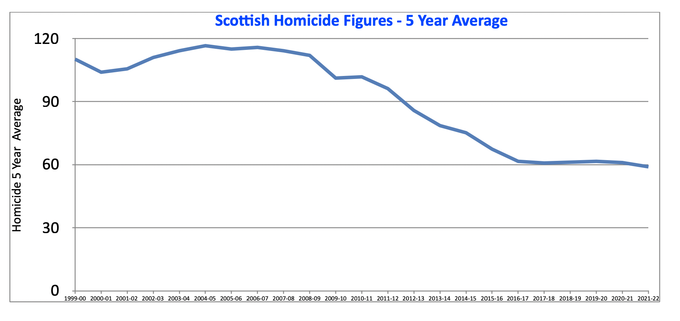
View of Scottish Homicide if viewed as 5 Year Average
Presents clear view of ongoing improvement
Source:- Homicide data-tables-updated-11-01-2023
Notes:
When we consider that Police Scotland were proclaiming their significant success in identifying the murderers in our society, it seemed worthwhile looking at the data for homicide and how we both use and interpret.
This chart shows homicide in Scotland as a 5 year moving average. This gives the very strong impression of a steady improvement over an extended period. This in turn gives great comfort to public at large and in general I believe there has been an ongoing improvement. This appears to be supported in the reduction in reported violent crime.
It is amazing how flat lined the numbers are from about 2016 onwards, almost no variation?
This representation in reality masks the change that has occurred and one which should at least drive very real concrete concerns and raise questions.

Slide 10
Scottish Homicide Rates Compared over Time
Two Very Different Worlds
Scottish Homicide
2002 - 2012
Scottish Homicide
2012 - 2022
139
(95% Upper)
106
Average
73
(95% Lower)
60
Average
68
% Upper
52
(95% Lower)
Scottish ONS Homicide data-tables-updated-11-01-2023
Notes:
In this schematic we are using the raw annual data from the previous chart but we are now looking at the normal distribution profile of homicide in Scotland split into two time periods, pre 2012 and post 2012.
We can see that the two profiles are completely different groupings and it is clear that there must be something distinctly different about the two groups. Not one of the post 2012-22 numbers fits inside the 2002-12 profile.
It is suggesting that pre 2012 a result between 73 and 139 homicides would not be abnormal with 65% expected between 90 and 122. Where as post 2012 we expect results between 52 and 68 with 65% expected to fall between 56 and 64.
In my previous professional world, I would view them as completely different populations. It is saying something significant has changed. If our society has made such a remarkable shift in results should have books written about it.
With this perspective I do think we need to look further.
Raw Data
2002-03 123 (95% Confidence on 106 Average is +/- 9.8)
2003-04 108
2004-05 134
2005-06 95
2006-07 119
2007-08 115
2008-09 97
2009-10 80
2010-11 98
2011-12 91
2012-13 63
2013-14 61
2014-15 63 (95% Confidence on 60 +/-2.303)
2015-16 59
2016-17 62
2017-18 59
2018-19 63
2019-20 65
2020-21 56
2021-22 52

Slide 11
Scottish Homicide Rates Compared over Time
The 2012 Paradox - A new Statistical Paradigm
A reduction before SFIU
2012 - SFIU Set Up
Notes:
If you now picture the data we looked at earlier and apply the outside limits to what is called a Moving Range Chart, we start to see something more dynamic than just two differing distribution. This is constructed using Dr Donald Wheeler’s Moving Range Chart. (I will come back to this type of chart when looking at drug deaths where we can use this to look at when to intervene on a negative shift in results.)
This type of chart allows us to see when change occurs that takes us to a situation that is beyond what we see as the statistical normality. It cannot inform us what has change but it should narrow down where to look for the cause of change. (We seldom look at a positive change with an intent to learn, we have a tendency to assume we know the reasons.)
If we now look at homicide on its own merits, we see a fundamental shift in the numbers recorded changing statistically significantly from 2012 onwards. This was before Police Scotland existed.
The data before and after 2012 are significantly different, neither set of results fit into the expectations of the other respective group. The limits set here, are based upon the incredibly stable period from 2012 to 2020. They are dissimilar enough to recognise that a fundamental change has occurred.
The only thing that has obviously taken place is the set up of The Scottish Investigation Unit (SFIU). Why should homicide drop away because of the implementation of this organisation? The SIFU has the responsibility of investigating non suspicious deaths, so why should they make a difference?
Has society changed so much in a year? If so, we would have expected to see the same dramatic drop for violent crime. While it does improve over time, it des not reflect this dramatic shift.
If the new methods of assessment reduces homicide, then surely the question must be about the quality of convictions previous to his? If fundamental police investigation methodology has not changed, how do we get such a shift?
As these results have changed so dramatically in a year, we should have a good recording of what society behaviours drove this immediate change. Do we?
(It should be noted that a running 5 year average hides this remarkable change and as seen shows a steadier and less dramatic shift to the new paradigm.)
We now need to look at what we believe can give us some insight to the changes and we will start by looking at the small but reasonable improvement noticed in the 3-4 years before 2012.

Slide 12
The Basis for Deciding Homicide in Scotland?
Former Police Superintendent from Paisley - Quoted 28/2/2024
“A suspicious death is only generally only regarded as a murder after a post mortem and after agreement between Procurator Fiscal and Police.
I had a case where an individual was beaten repeatedly over the head with objects and ultimately had their throat cut.
No murder was libelled as the pathologist could not identify any injury that was ultimately fatal.”
Commenting to media (28/2/2024) following Perthshire Shooting
Notes:
An interesting comment was made to the media in the recent case of the shooting murder in Perthshire. Not only is it strange that someone can be shot in the chest and face and the initial belief is not suspicious but the inputs from the retired officer is both interesting and worrying.
Despite this awful situation where it is almost unbelievable that this is not a murder, he is stating it was not followed up as one because a pathologist could not identify the fatal injury. This not only raises questions of what it takes for a death to be deemed a murder in Scotland but also the singular importance placed upon the pathologist (COPFS funded) findings.
Another very important consideration is asking, where was this death recorded. There is only suicide and accident as an option. This becomes an important point as we progress through this information.
(In Colin’s, Annie Borjersson and Annie Davies cases there deaths were written off by the pathologists and yet when independent experts are used they disagree with COPFS funded pathology.)
So this leads us to look at some of the changes we witnessed before the large drop off in homicide rates.

Slide 13
Death Certificates and Coding The Cause of Death
National Records of Scotland - 2008 Change to Procedures
“In the case of drug related deaths, NRS also seeks information from pathologists, including details of the substances that were thought to contribute to the death, other substances found in the body and the pathologist’s view of the cause of death.The form used for deaths in 2007 (and earlier years) asked the pathologist to indicate whether the overdose was believed to be accidental, suicidal, homicidal or unknown/uncertain, by ticking the appropriate box. The form used for deaths in 2008 (and later years) does not specifically request that information.” - National Records of Scotland - Online Document
https://www.nrscotland.gov.uk/statistics-and-data/statistics/statistics-by-theme/vital-events/deaths/deaths-background-information/death-certificates-and-coding-the-causes-of-death/sources-of-information
“As an investigator, one of the key requirements of a Pathologist is to determine if this was a homicide. If it was, or if it is not possible to say, then I need to conduct a thorough and thus expensive investigation. How could the removal of this key question be justified unless it was to allow someone less qualified to manage the figures.”
- Tony Whittle Ex Head West Yorkshire CID and Homicide Training expert
Notes:
As we saw, there was a stepped reduction prior to the full set up of SFIU in 2012, these comments highlight a concern relating to what was part of that reduction.
Throughout the years there are a number of changes on how we record death, how we measure cause and who is involved. Does this matter?
In assessing this importance it is essential to bring into account the view of the ex senior officer on the importance of pathology in cause of death.
If we look at drug fatalities as a very significant cause of sudden death, we see an important change in requirement on how to assess the cause of death as accident, self harm and homicide.
This was a question that was rightly asked of a pathologist. In 2008 this was changed and the pathologist was no longer required to make that assessment.
As we can see from the ex police officer from Paisley and take in the importance also raised by ex Head of West Yorkshire CID, they both see the criticality of pathology and yet! This seems like a very serious and significant step away from ensuring the fundamental integrity of an investigation.
We will look at how this has affected data for drug homicides.

Slide 14
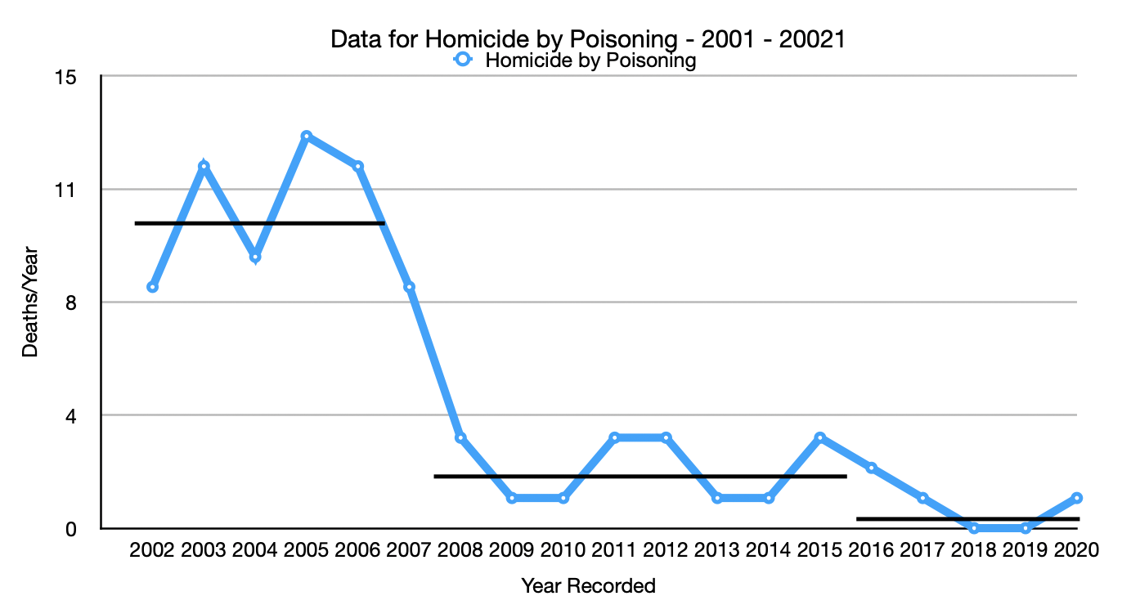
Scottish Homicide Rates Compared over Time
Death Certificates and Coding The Cause of Death
2008 Pathologist no longer asked to determine if homicide
(1) ONS Scottish Homicide-21-all-tabs
Notes:
Very simply, homicide by drugs is virtually removed as a cause of homicide. If it is not reduced by this removal of expert pathology opinion, what caused it?
The fact that the pathologist is not asked to record their opinion on any cause of death must raise questions beyond just that of homicide. How are we assessing the cause of death? How can we stop deaths occurring if we are not attaining the best insight into the cause?
This does not explain the size of drop over the 2008-12 window but explains a fair bit and we do believe that there has been a reduction in homicide. At no time am I trying to suggest that there has been no improvement.
We need to now look at the significant drop after 2012 and see if we can make some sense of this change.

Slide 15
The Shifting Face of Sharp Force Fatalities in Scotland
(1) ONS Scottish Homicide-21-all-tabs
(2) ONS Scottish suicides-22-all-tabs
Notes:
The singular greatest change in reduction of homicide comes from a vast reduction in deaths from sharp force instruments.
We can see that in the 9 years up to 2012, there was 470 recorded deaths and this reduced to 274 in the 9 years following 2012. This is a major commendable drop. We have had stop and search and a change in law for possession of a knife.
I think that hospital admissions support that there has been a drop. The concern I have and it is from our family’s personal experience as well as from the data.
We see that while there has been a significant drop in homicide, there is also a significant rise in suicide under the same cause of death. Why would we see a reduction in homicide at the same time as a rise in suicide?
The drop of 30 homicides in 2012 were driven by a reduction of 21 sharp force homicides. It is interesting that in 2014 sharp force injuries increased again by 11 but no noted increase of homicides occurred ?
From our perspective as a family, if Colin Marr’s death could have been deemed a suicide when he was stabbed through the sternum, anyone’s death could be.

Slide 16
Notes:
As we have seen, at the very same time we have seen the reduction in homicides for sharp force injuries, we see that self inflicted deaths have taken an upward trajectory to the point we should be very concerned. It has to be noted that the upward trajectory begins in 2012.
We really need to know why would homicide by sharp force injury be so stable and self inflicted be constantly increasing and going out of control? In fact, for the first time ever, as best I can see, we now have more suicide by sharp force injury than homicide.

Slide 17
Sharp force injury Fatalities
1 - If we take consideration of other facets of the wounds being neutral by looking at some of the facts taken from a 16 year study of Homicide and Suicide (2) in Humberside (1975 -1991) the following data emerges;-
In the study of 273 suspicious deaths by stabbing, 79% were homicide and 19% were suicide.
Today data in Scotland could suggest that suicide by stabbing is now greater than by homicide
Notes:
The most disconcerting thing about this rise in self inflicted sharp force injuries, it is in serious conflict with historical expectations. In the past, the number of homicides to self inflictions was about 4:1 and now we are recording more self infliction than homicide. What has changed and why has it changed significantly from 2012?
In light of comments and actions on pathology, my belief that homicide is only accepted as fact if it is ruled by a pathologist. This would rule out many historic homicides and anything that required significant investigation to understand what has really taken place.
It is worth noting that in the cases of Annie Borjesson, Stefan Sutherland, Annie Davies and Kevin MacLeod and Colin Marr, their deaths were ruled suicide or accidental with no investigation taking place. In fact, COPFS instructed police to open homicide investigations in the case of Kevin and Colin, they chose not to. There was no repercussions for this failure to act and in fact kept the previous failings hidden for some time. This was a failing of senior officers.
(by contrast a young officer in Airdrie was jailed for failing to arrest a suspected burglar!)
This quality of investigation or lack of is something we will come back to.

Slide 18
Implications for Sudden Death Analysis
Notes:
In this section I will look at this shift in metrics and how it may affect other categories for cause of death.
Is it possible that things are not improved to the extent we are led to believe and it is possible that numbers are being moved across cause of death categories.

Slide 19
FOUR STEPS TO WISDOM
The fundamental point is that the quality of the data, the ability to structure
and assimilate findings profoundly affects your ability to take positive
appropriate actions.
Wisdom
The ability to act on the knowledge gained
Knowledge
Interpretation of the Integrated information
Information
One person’s knowledge can be another’s data
Raw Data organised into Structured Picture
DATA
In the context of our need to understand how to improve,
this step can be seen as quality of sudden death investigation
The most basic event level of Analysis
Notes:
It may seem a bit over the top focussing on the depth and quality of investigation but it is at the root of how we understand cause of death and ultimately how we can ultimately effect change.
This simple model shows how we should expect to see a growth in how we develop data to ultimately drive actions based upon absolute knowledge.
If we build the depth of knowledge to truly understand what is going on, we would surely develop the wisdom to know how to make concrete change.
In analysing sudden death, we see that our understanding builds from the source of data from the assigned cause of death. That source of data needs to be robust for our conclusions to be meaningful.
It therefore must be remembered that it is the quality and decision making of the investigation that allows us to provide a single data point. This data point is the sum of someone else’s wisdom from the same fundamental model but in their case for a single death.
If that investigation lacks any thoroughness and pertinent scrutiny, it significantly affect our understanding and ability make a meaningful intervention.
We do have excellent data collection but is it robustly developed? Is it easy to use? Is it definitive enough in helping form active decisions and who really acts upon it?
The fact that we are missing important changes of death in society and failing to take responsive actions to correct them should be an alarm that something is wrong.
I think the changes being made in cause of death assessment can be viewed through this very simple model. If we reduce the “intelligence” in the quality of data being introduced into our understanding of cause of death we seriously impact our ability to act appropriately.

Slide 20
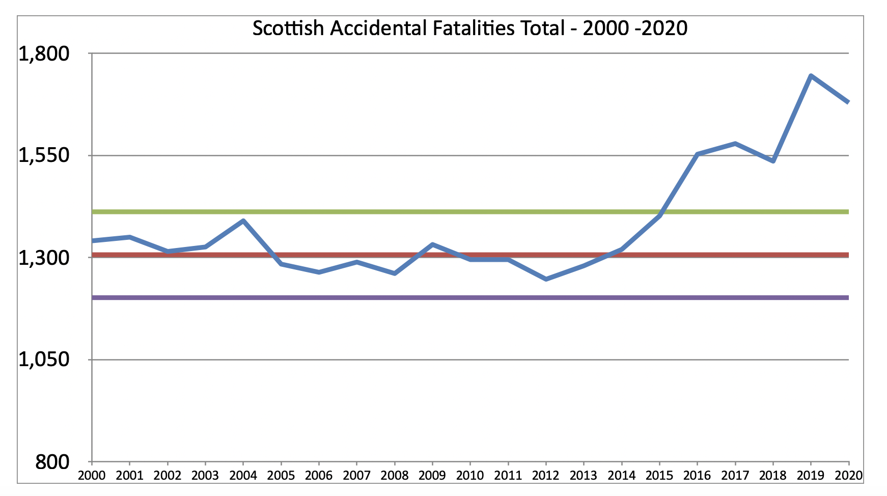
How Effective is Our Management Of Sudden Death
The Rise in Accidental Deaths Death
Clearly going statistically out of control
in 2015
SFIU Begins
Notes:
Not all of the major concerns worthy of looking at lie within the homicide and suicide categories. the numbers for accidental death is also alarming and showing that it is out of control with no perceivable intervention.
As we saw earlier with homicide, we can use statistical limits to keep us aware when a change of significance occurs. Numbers can and will rise and fall and we should not over criticise or over praise with a short term directional shift. However, we see that using dynamic these statistical limits, we should have been forced to intervene to understand what had changed and take action some 9 years ago.
Whatever is thought of this analysis, there is undoubtedly a significant increase in sudden deaths across a broad spectrum of causes.
What is alarming is that Suicide, drug deaths and accidental deaths are part of Social Justice and do not get the same focus or resource as Criminal Justice receives.
What is also of interest is that the number of fatal accidents appears to coincide with the introduction of The Scottish Fatalities Investigation Unit (SFIU) in 2012. Why would accidents shoot up with a perceived improved focus on investigation.
Like homicide, we can look a bit deeper to understand what is causing this growth in accidental death numbers.

Slide 21
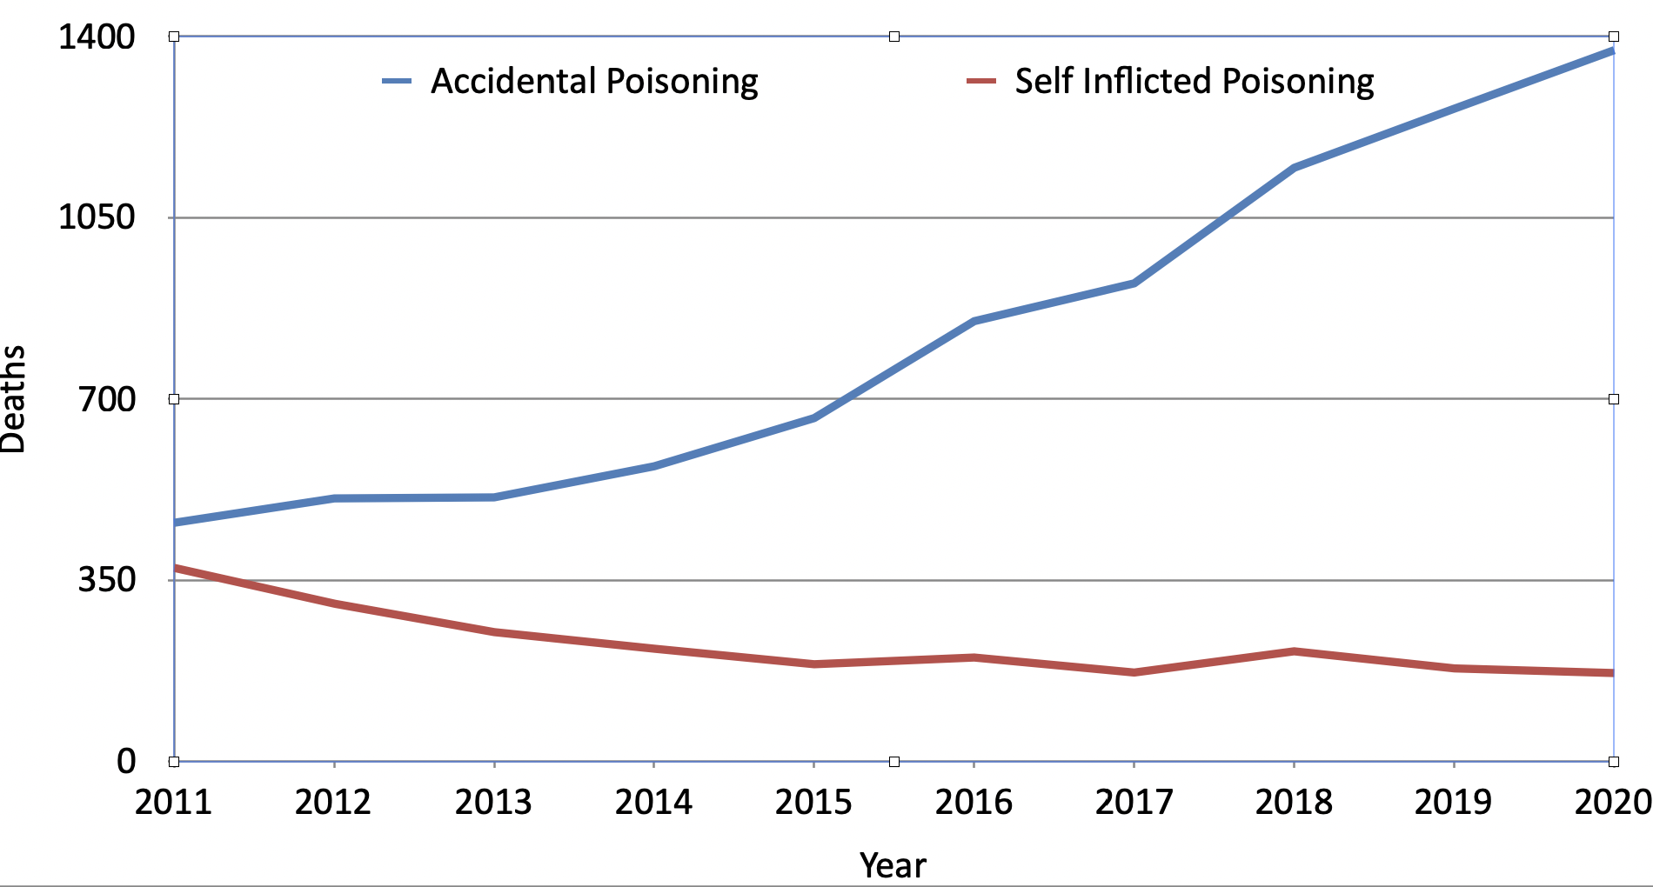
The Changing Face of Death by Poisoning
1373
461
374
171
(1)ONS Scotland accidental-deaths-20-all-tabs
1. Following a WHO update to the international Statistical Classification of Diseases and Related Health Problems, the definition of accidental deaths changed in 2011. This chart shows the numbers of accidental deaths according to both the old and new classification
© Crown Copyright 2019
(2) ONS Scottish suicides-22-all-tabs
Notes:
We can see that accidental poisoning (drug deaths) accounts for a significant shift in accidental deaths. However, again we see numbers growing in one category and reducing in another. Why would accidental deaths increase as suicide has reduced?
The concern is that by this movement to accidental deaths by poisoning from suicide in turn may reduce the focus and acknowledgement the scale of mental health deaths we have in Scotland?
Also, by having such a swamping of accidental deaths by poisoning (Approx from 17% 2010 to 50% 2020) we can mask any underlying increase in other categories that may not be getting the level of attention required. Underlying accidents grew from approximately 1200 to 1400 in this same time frame. (This is clear to see in the Scottish ONS Chart from this period but scale of poisons can mask the need for attention.)
Even this growth in accidents is partially masked as there is an improvement in transport fatalities over the same window. (212-150)
This leads us on to looking at what else is actually happening.

Slide 22
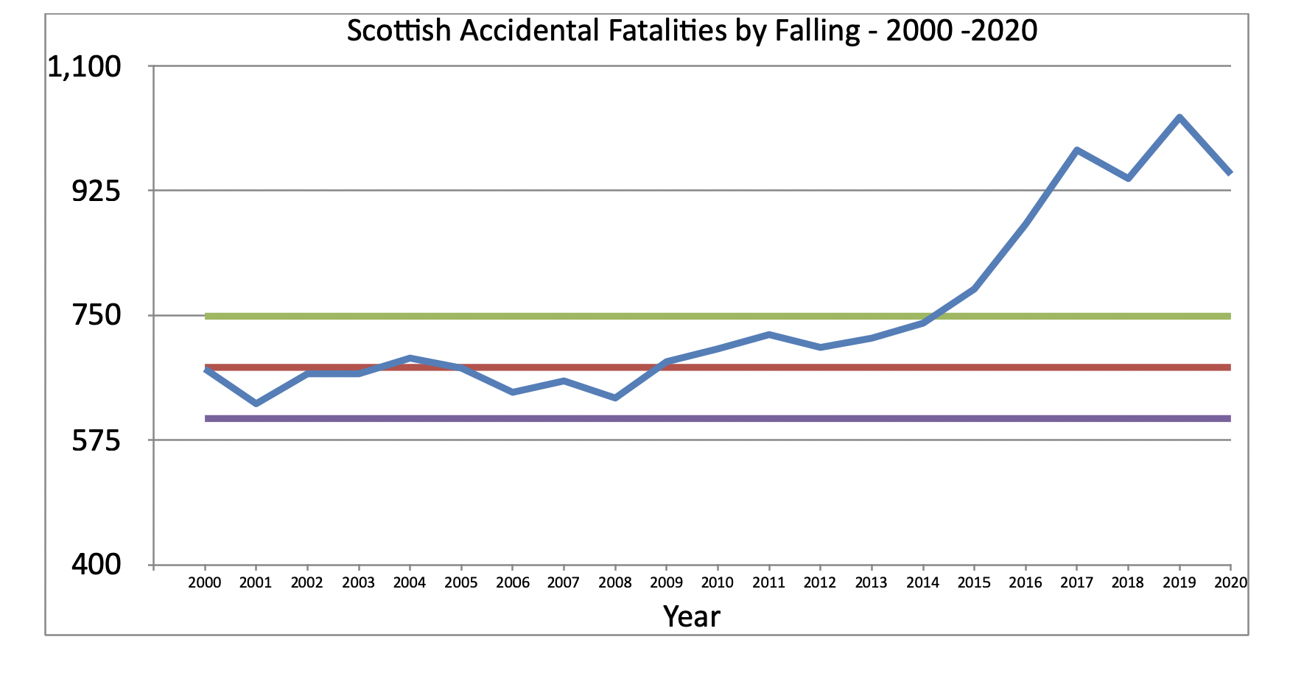
Accidental Deaths from falls
(1)ONS Scotland accidental-deaths-20-all-tabs
Notes:
We see that accidental deaths from falling has gown rapidly over the last decade or so. If we look at this in some detail, there appears to a shift up in 2008 to 2012 and then steady growth thereafter to a new levelling from about 2017. This is in fact a reversal of the homicide profile.\
It appears we are seeing significant sifts in allocation of cause of death in the very same time profiles across a broad front.
The most important aspect of this is that we have another cause of death that should be getting focus and addressed.

Slide 23
How Does Reduction of Poison Suicide Mask Underlying Suicide
ONS Scottish suicides-22-all-tabs
ONS Scottish suicides-22-all-tabs
Notes:
We have seen that suicide for self poisoning has been reducing and this undoubtedly has played a significant role in our overall suicide numbers stabilising (bearing in mind that like homicide, this was another area that had incredible media focus around 2010) and in fact showing a slight decrease overall.
What we are seeing is the reduction in suicide by poison reflecting in the overall numbers dropping but masking another area of consistent growth. That is, underlying suicide with drug deaths removed is growing but being hidden by the apparent .movement of deaths from one category to another
We can see that numbers appear to be shifting from one category to another and yet have the same underlying cause of death. This is disconcerting as we can miss the significant changes that are taking place and the scale of a problem may be much bigger than we first thought.
It is also concerning that we can shift cause of deaths from groups that have greater emotional support from society into a group that definitely does not have the same public angst.
(This slide develops when in play mode)

Slide 24
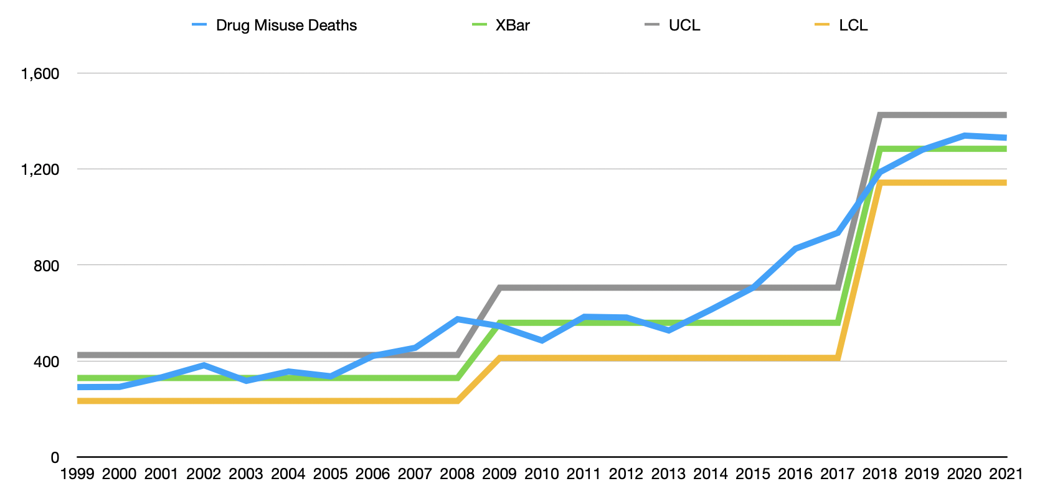
DRUG DEATHS IN SCOTLAND IF VIEWED WITH DYNAMIC STATISTICS
UTILISING WHEELER MOVING RANGE STATISTICS
Again, if Wheeler MR statistics were used
we would have see a clear change again in 2015.
If Wheeler MR statistics were used
we would have been concerned in 2006 and
knew there was a problem in 2007.
Notes:
I wanted to look at the changing face of drug deaths and examine the changes in the numbers as they are recorded year on year. It allows us to question, why so little has been done when it is clear there have been more than one significant kick up fatalities.
Therefore, this is another look at the impact of drugs but this time we are again looking at drug deaths. The important part here is that we are now applying statistical control lines and are considering the data in both a dynamic and simultaneously statistically meaningful.
The early lines are developed using the data from 2000- 2006. We are looking at the “normal variance” that is occurring at this point. The limits are set at +/- 3 sigma. i.e., where 99.7% of results would be expected to occur. (Moving range)
Using these control lines based upon a relatively stable period prior to 2006, it should have forced us to ask a question in 2006 about the increase but we would know there is a problem in 2007. It is important to remember that only in about 1000 results would be expected in that location and obviously this is even more amiss in 2007 and needs to be considered that you would not expect two concurrent years to be on the extreme of expectation. (See next slide for Petition)
This would appear an earlier warning/signal of change than any analysis we have seen from this period.
For us to be effective however, we need to have an understanding of statistical meaning but more importantly, possess the Leadership with accountability that actually makes a difference. It all starts with the questions raised but we need to have the “anxiety” to be worried about this development and have someone tasked with “fixing”.
In all, if we look at when the narrative develops to raise questions on sudden death issues in Scotland, it is invariably years after the problem begins to escalate. Not only does this lead to thousands of deaths but we need to consider that many are probably preventable.
We need to understand that our behaviour also grows to accept the status quo. Initial when we get to around 1200/year deaths for drug related issues it is a shock and over time it becomes the norm. We lose sight of the individuals and their families.
Could we take lower cost dramatic accident as problems arise rather than wait on hundreds to thousand of deaths to implement costly solutions?

Slide 25
As Usual - The Public seem to know and Care more than Government
PE00995 - 24th July 2006
Petition by Robert Patterson calling for the Scottish Parliament to urge the Scottish Executive to hold
a public inquiry into the high number of drug related deaths in Scotland
Who Contacted
Nicola Sturgeon MSP
Councillor William McAllistair
(20 March 2007 : The Public Petitions Committee agreed, on the basis of the extensive activity in relation
to drug-related deaths in Scotland already being undertaken and that the case for a public inquiry does
not appear to have been made, to close consideration of this petition)
Notes:
At the same time as data shows a statistical change, member of public raises concern via petition to Scottish Parliament. The questions it brings to the fore is to ask who actually cares in Government, then and now. (This was pre SNP)

Slide 26
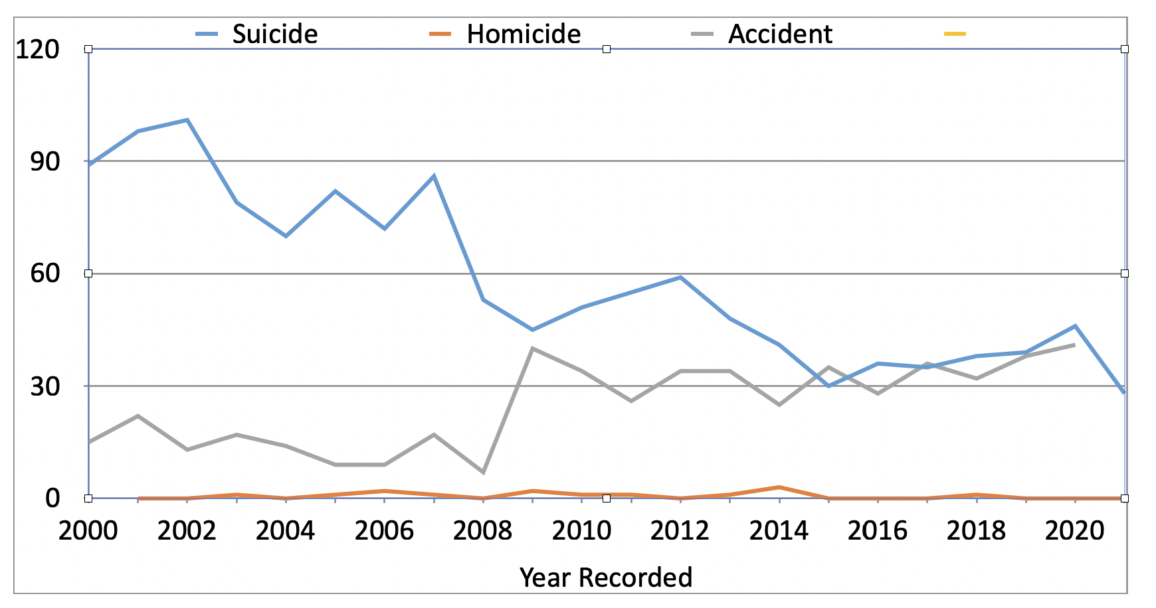
Shifting Cause of Drowning in Scotland
Notes:
Just used this chart to show that again we have a move from suicide to accident. I have to stress again that it is hard to find any outrage or concern for accident versus suicide. In this chart we see that again as one category of sudden death goes up another goes down.
Very little change in what is taking place but a change on emphasis the reviewing the numbers. If the numbers are genuine we should be asking what happened around 2008 to reduce one and increase the other?

Slide 27
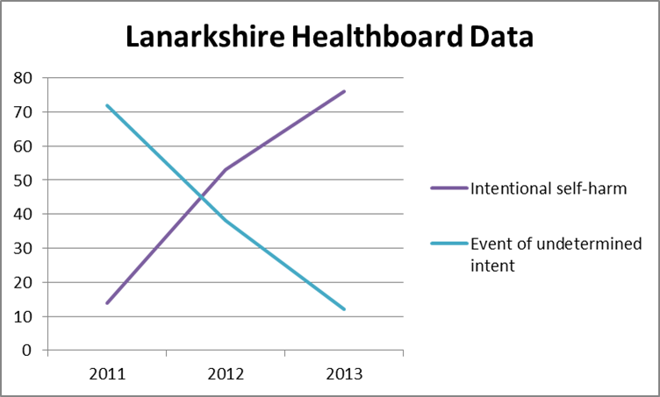
Scottish Self Inflicted Statistics - Undetermined Death
Significant Change in Allocation Pre and Post SFIU
Notes:
If we now look at change of ascribed sudden death in a single region over the window that SFIU was set up, we see dramatic shift on what is being recorded. If this was a genuine change in investigation capability, we should have something recorded to highlight what has changed.
We are moving from having uncertainties about cause of death to being very certain. Again our families know from personal experience that it is incredibly easy to have a death signed off as suicide and this says that it is being done with greater certainty.
It brings us back to the individual that had been repeatedly beaten over the head and had their throat cut, would this have been a determined self inflicted death or undetermined. There is no category for possible or probable homicide.
It seems more and more we are saying, “nothing to see here”.
Would it be positive to roll this out nationwide in a year? Is this feasible? What changed in investigation technique?
Is this simply just a decision to record in a specific way?

Slide 28
Scotland Sudden Death Escalation In Crisis
2010 2020
Drug Deaths (1) 293 1373 (+469%)
Falling (1) 703 948 (+34.9%)
Self Infliction(2) 529 634 (+19.8%)
(1525) (2955 +93.7%)
Death in Prison(3) 15 34
Under 18 Year Olds (4) Scotland has a higher mortality rate for under 18s than any other Western European country, with over 300 children and young people dying every year. Around a quarter of those deaths could be prevented.
(1) ONS Scottish accidental-deaths-20-all-tabs
(2) ONS Scottish suicides-22-all-tabs (removal of drug/poison deaths masks an actual underlying increase for other causes)
(3) Nothing to see here? Deaths in Scottish Custody 2023 - Professor Sarah Armstrong et al - Glasgow University
(4) National Hub for Reviewing and Learning from the Deaths of Children and Young People 2021)
Scotland Population 2010 5.25M ——-2020 5.47M (+4.2%)
Notes:
In 2010 we had 1777 deaths for the first 3 categories
in 2020 we 3126 deaths an increase of 1349 deaths/year
or 75.9%
Self infliction numbers only tell part of the story. As suicide attributed to drugs declines (252 to 171 - (-32%) and simultaneously accidental drug deaths increase it masks the underlying growth attributed to self infliction. (529 to 634 - +19.8%)
The worrying aspect is that moving cause of death from one category to another can mask overall changes. It appears evident that having drug deaths included in the accident category, significantly masks the large increase in death by falling. +36%
If we could only cut the growth in these deaths by about 50% we would be saving over 650 lives per year.

Slide 29
The Organisational Limitation
Notes:
The cause of our failure to act, obviously lies in the realm of government but I believe that we have been historically and systematically set up to fail.

Slide 30
Organisational Effectiveness Dynamic
STRUCTURE
CULTURE
CAPABILITY
Poor Structure impacts Culture and inhibits Capability
Notes:
The inter-relationship between structure, culture and capability.
This entire presentation was really started after Police Scotland stated that they had 100% closure on homicide. This is a performance issue borne from a culture allowed to develop in an inadequate structure. (Misplaced accountability)
Leadership is obviously the key driver for success, but what happens when the structure gives the wrong leader in the wrong position. I do believe that ownership for sudden death resides in the wrong location and best will in the world could not deliver the results required.
If we do have a structural problem, we have to consider how this plays out in a “political” world rather than one with appropriate accountability. This cultural effect goes hand in hand with capability.

Slide 31
The Role of COPFS
Inspectorate of Prosecution in Scotland Report - 2016
The primary purpose of the investigation is to ascertain a cause of death, although there are a number of other aims of the investigation, including:
To ensure any criminality is discovered and where appropriate, prosecuted;
To allay public anxieties about particular deaths;
To alert family members to any genetic causes of death, which may be avoidable; and
To maintain accurate death statistics.
Inspectorate of Prosecution in Scotland - Thematic Review of Fatal Accident Inquiries 2016 - Page 10, Point 30
https://www.gov.scot/binaries/content/documents/govscot/publications/research-and-analysis/2016/08/thematic-review-fatal-accident-inquiries/documents/00504451-pdf/00504451-pdf/govscot%3Adocument?forceDownload=true
Notes:
We know that COPFS and SFIU through them are responsible for investigating sudden deaths. In our case when focussing on Suicide/Accident and Homicide, when you look at the core focus of their organisation it is about serving their core function of prosecution and little else.
In doing this role they evaluate and investigate in excess of 10000 deaths per year.

Slide 32
The Role of COPFS
Inspectorate of Prosecution in Scotland Report - 2016
While the number of deaths reported to COPFS has reduced in the last three years, there has been a significant increase in the proportion of deaths requiring investigation. This reflects:
An evolution in the public’s attitude to death, with a greater expectation of being involved in all important decisions regarding relatives and, in obtaining more information on the circumstances of the death;
Against this background, the number of FAIs held is extremely low, representing
0.7% of all deaths investigated.
Inspectorate of Prosecution in Scotland - Thematic Review of Fatal Accident Inquiries 2016 - Page 7, Points 17 & 18
Notes:
Even with an understanding that public’s attitude is changing we see FAI’s at 0.7% and this is the lowest level of public testing of in our history. FAI’s are our nations only attempt (save a few public inquiries) at pretending to understand and learn from any of the sudden deaths. We can see by the number of FAI’s we have, it is such a trivial treatment of such a serious issue.
We only have FAI’s where it is deemed we have something to learn (we look at our learning later). We have some of the poorest death statistics and have the lowest public enquiry levels in the English speaking world. Why do we learn nothing?
Homicide is the other main vehicle where the public can assess the depth of an investigation. This in principle should be the most intensive investigation but it does not look at how we got to the point of why someone got murdered.
Barry Dixon was murdered by someone who was in breach of curfew and was in breach of several bail orders. This individual was violent earlier than when he killed Barry and was not arrested or detained by police. A murder trial does not deal with this or put expectations on the police to take action on their failings. Why should Barry’s family go through significantly more emotional trauma to fight for this?

Slide 33
The Lord Advocate and FAI’s
The Lone Decider of Learning from Death
The Act retains the requirement to hold an FAI where a death occurs in Scotland as a result of a work-related accident or where the deceased was in legal custody at the time of their death. Such inquiries are referred to as "Mandatory inquiries”. The Lord Advocate can decide not to hold a mandatory FAI, if satisfied that the circumstances of the death have been sufficiently established during the course of other proceedings.
The Act also retains the discretion of the Lord Advocate to hold an FAI into a death which is sudden, suspicious, unexplained or has occurred in circumstances which give rise to serious public concern. Such inquiries are referred to as “Discretionary inquiries”.
There are also understandable differences in scale; in 2014, for example, the coroner opened 25,889 inquests compared to 34 FAIs held in Scotland.
- HM Inspectorate of Prosecutions in Scotland 2016 Report
THUS ALL SUDDEN DEATH SCRUTINY IS AT THE WHIM OF THE LORD ADVOCATE
What Does the Lord Advocate know about Drug, Suicide and Accidental deaths that makes them closed to public scrutiny and the potential to learn?
Notes:
As stated, in Scotland we have one vehicle for actually publicly testing the findings in cause of death. This is the Fatal Accident Inquiry.
Most FAI’s are mandatory cases and others at the discretion of the Lord Advocate. Mandatory cases are things like death in custody, later we will briefly look at how good we are doing with this.
Even in the mandatory cases, The Lord Advocate has he right to prohibit them. So, in effect every FAI is at the Lord Advocate’s discretion, not the need for society to learn or for the families to have answers.
How many times do we see families asking for FAI’s as they want questions addressed only to be told that they could not have one. If it was not for the families that lost their loved ones in the Cameron House fire, there would have been no FAI and the important learnings would have been missed.
Without going into the atrocious delays in FAI’s, their meaningless findings, their limited impact on society, how can a single individual determine if cause of death has meaning without participation from ALL impacted parties?
Nevertheless this is what we have.

Slide 34
Nothing To See Here
Deaths in Custody 2023 - An insight into how effective FAI’s are
Four people die every week in Scotland while detained or under the control of the state –we counted 244 people who died in a year’s worth of information, in various forms of state detention or care.
Police: 26 people died in custody and 198 after police contact between 2015 and 2023. Police contact deaths are increasing.
Mental health detention: 673 people died between 2018/19 and 2022/23. Deaths have been increasing among this group.
Migration detention and asylum accommodation: 16 people died in Scotland between 2016 and 2023. Deaths have been rising since the pandemic in this group.
Looked after children and young people: 111 died between 2014 and 2021. Deaths have been on the rise in this group.
People with learning disabilities and autistic people: 14 people died while psychiatrically hospitalised between 2015/16 and 2021/22. Deaths in this group do not seem to be on the rise.
Prison: 346 people have died in prison between 2014 and 2023. Deaths in this group have been rising for many years, and this accelerated in the pandemic.
Investigations of deaths vary by setting of custody. Most are not subject to a fatal accident inquiry. Most are internally reviewed with no public reporting of outcomes.
Sarah Armstrong, Betsy Barkas, Linda Allan, Stuart Allan and Debbie Cairns - Glasgow University February 2024
Notes:
In a very current analysis of death in custody that was developed out of Glasgow University a detailed look at the effectiveness of FAI’s was examined.
We can see here, like that we are seeing in society at large, there is significant increases in deaths across a broad spectrum of areas of detention. Surely with this underlying backdrop and the fact that FAI’s are supposedly mandatory, we would hope critical lessons would emerge and learnings implemented?
This report is very important as it is dealing with a large number of the FAI’s that has actually taken place. Bearing in mind that FAI’s look at around 0.7% of fatalities, so this gives the best insight into how we look at sudden death in general.

Slide 35
Nothing To See Here
Deaths in Custody 2023 - An insight into how effective FAI’s are
FAIs over the past year
There were 22 FAIs into deaths in custody published in the one-year period October 2022 to September 2023. Twenty of these FAIs involved deaths in prison; one was police custody and one was migration detention.
Most involved health conditions and incidents (13 deaths); the rest were suicide (5) and drug (4) deaths.
Over three-quarters of FAIs took more than two years to complete; over a third (8) took more than 3 years.
Corrective findings are rare: Over 90% found neither a precaution or a system defect (2 FAIs in each case); 4 FAIs made recommendations.
No FAI into suicide identified any precautions, defects or recommendations aimed at preventing deaths in similar circumstances.
Families mostly were not involved in FAIs: only 7 had legal representation (32% of FAIs); 9 attended some or all of an inquiry; only three gave evidence.
This contrasts with the involvement of those responsible for the care of the person who died. In terms of legal representation, the Scottish Prison Service had this in 100% of prison deaths; NHS Scotland or its staff were represented in 68% of FAIs; prison officers/Prison Officer Association lawyers were involved in 50% of prison death FAIs.
Sarah Armstrong, Betsy Barkas, Linda Allan, Stuart Allan and Debbie Cairns - Glasgow University February 2024
Notes:
We see that, even today we see virtually no learning to be had from the death of individuals and families are not part of this system.
We also see that when the FAI was held, all Government institutions were legally represented.
In the case of Colin Marr, we had an FAI where we had a lawyer allocated for a week before the FAI and to represent his family through the Inquiry. At the FAI, the institutions that let him down, COPFS, Police and Pathology all had QC representation. The person who had previously been detained as a suspect had a Junior QC and a team of Lawyers funded by Crown. There was an argument they wanted to win and they weighted it accordingly.
We even had evidence withheld and police lying and misrepresenting in court but apparently this is not illegal?
The bottom line our experience was that the FAI was not about the truth but an attempt to remove any blame for failure on the institutions.

Slide 36
Nothing To See Here
Deaths in Custody 2023 - An insight into how effective FAI’s are
FAIs over the longer term
We identified 227 FAI determinations involving deaths in prison published through September 2022, covering deaths occurring between 2005-2020.
Of these, only 34 (15%) made a finding of precaution, defect or recommendation.
Overall, the average time to complete an FAI was 735 days (about two years), and the median time was 655 days.
Since 2017, when a newly reformed law came into effect, FAIs are taking longer, make fewer findings, and involve families less than FAIs before 2017.
There have been no completed FAIs (as of September 2023) for anyone who has died of Covid in prison, nearly four years after the first such death occurred.
Sarah Armstrong, Betsy Barkas, Linda Allan, Stuart Allan and Debbie Cairns - Glasgow University February 2024
Notes:
This report from Glasgow Uni took in an even longer view of FAI’s and I think the most dramatic aspect is that only 15% of FAI’s made a finding of precaution.
If we simply extrapolate to the fact that FAI’s only account for 0.7% of sudden deaths and we only have 15% with some sort of learning. Without looking at the value of the learning, this shows that we are only learning form 0.1% of sudden deaths - 1 in a 1000).
I am sure there will be arguments that we learn elsewhere but if this is not open to public testing and scrutiny anything can be said with little value. Our increasing sudden deaths should be the only barometer to how effective we review cause of death.

Slide 37
The Misplaced and Disproportionate ownership of Sudden Death Investigations in Scotland
Police Investigate Sudden death
Non Suspicious - Suspicious
SFIU (COPFS) Investigate approx 10000/deaths/Yr
Court Cases
The only public testing of cause
of death in Scotland - 1.35%
Delays in FAI’s could suggest that
prosecution is the key priority
over learning
Suicide
Accident
Crime
Crime
Drugs
COPFS TAKE ACTION in about 1.35% of cases
(Homicide/Driving Negligence/FAI’s)
With Best will in world COPFS ar not focussed on 98% of sudden deaths in Scotland and yet have primary oversight
Notes:
So Why does this come about?
This is a very simplified version of our system. I believe that Police report suspected homicides/criminality directly to COPFS.
If we consider investigation and findings of sudden death from 2012 onwards, we see the introduction of The Scottish Fatalities Investigation Unit. This unit reports into COPFS.
The problem here is that what they are ultimately testing for are cases that should/could be open to prosecution or some form of Judicial hearing. (Homicide/Auto manslaughter/FAI’s).
The total view will also include deaths in hospital etc.
Out of approximately 10000 deaths COPFS are really only interested in about 135 cases or 1.35% of the total. They have to take these 135 cases and merge them into their dealing with an excess of 170000 crimes/year.
COPFS have no vested interest in any of the other cases and it is no surprise it is to big on their agenda.
However, the other excess of 9800 deaths are where the crisis resides!

Slide 38
Scottish Fatalities Investigation Unit
Do we have the capacity for thorough Investigations?
There are about 55,000 deaths in Scotland every year, and we get 11,500 of them reported to us, so roughly 20%. My role here is to try to reach out and explain to the medical profession not to report deaths to me which are natural and unavoidable, and to try to explain to them that's what they should be doing and to empower them in so doing, to explain to them how they go about getting advice in order that they can do that. And that is all about trying to minimise the distress and upset caused to nearest relatives. …….
I would say that over the last three years or so, we've managed to reduce the numbers of inappropriate deaths reported to the Fiscal by about 1,200 deaths per annum. So that's a significant number. I still believe that there are quite a significant number in there that should not be referred to us, and it's that group that I'm hoping to try to reduce by being involved in initiatives like this. I think there are probably somewhere in the region of 1,500 to 2,000 deaths which could be given a Medical Certificate, without being referred to the Procurator Fiscal.
- Then Head of Scottish Fatalities Investigation Unit (SFIU) David Green in an Address to NHS in 2019
(This followed a previous request by Catherine Dyer Crown agent in 2016)
Notes:
The comments from 2019 from the then head of SFIU David Green. If we re processing too many deaths, we are likely to overworked or under resourced.
It is a simple fact of life, corners must be cut to stay on top of investigations or a forever growing backlog of cases. Thus, quicker and simpler assessments of cause of death must be the outcome.
This also has to be taken with the level of stress policing appears to be under.

Slide 39
Contrast in Sudden Death Recordings
2010 versus 2020 Sudden Death Totals - COPFS Owned v Other
COPFS PRIMARY FOCUS
Notes:
If we now look at some of the categories that I have focussed on as part of this analysis, we can see that where COPFS and Police have responsibility, there has been a reduction in the numbers recorded in 2020 in comparison to 2010. For the others the opposite is true.
I think a good example of the difference in attitude can be seen through a fatal car accident. We see teams of experts arrive and the road completely closed until a full analysis has taken place.
By contrast, just last year in Fife, 2 young people were found dead in their home. On was in bed with some bruising to the face, the other was in the living room and the house had been ransacked. This was immediately seen as a drug death scene. It took 7 months later before toxicology results were given to the family over the phone and the only real communication with the family was through a SFIU administrator.
There are so many questions from this death but police nor COPFS were interested.
Why did these lives matter so little?

Slide 40
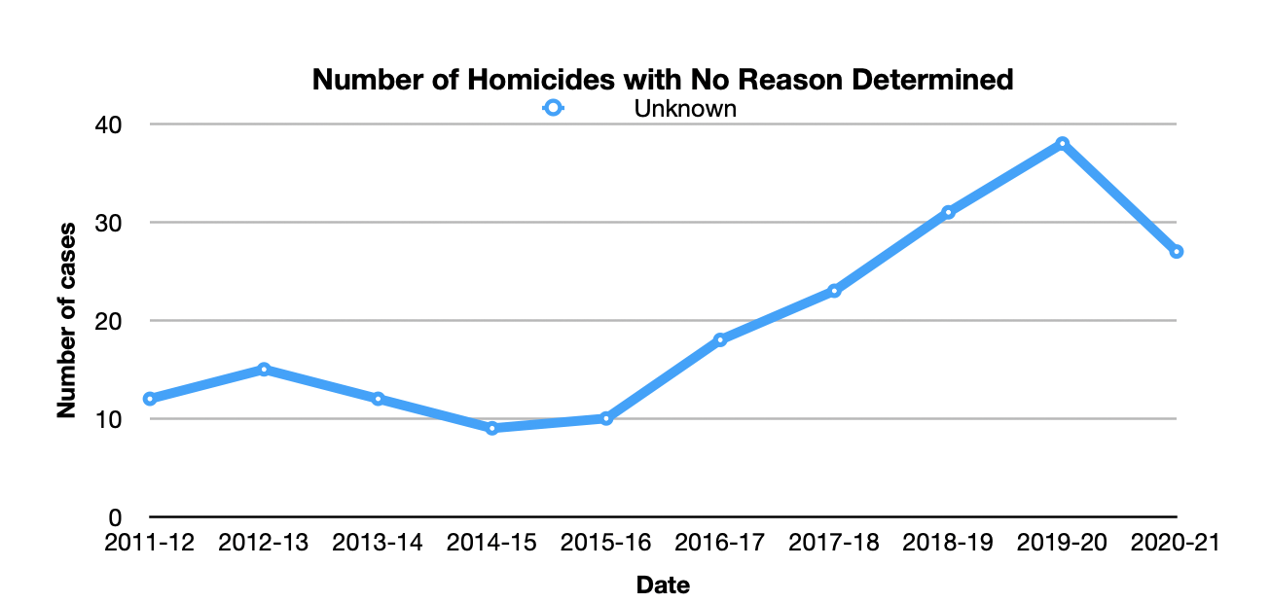
IMPACT OF SCOTTISH FATALITIES INVESTIGATION UNIT ON HOMICIDE COMPREHENSION
If our investigations are more thorough and homicides are greatly reduced, why do we know so little?
SFIU Instigated
Notes:
Is our quality of investigation improving?
Another simple check on our ability to determine effectiveness in our investigation capability is to look at our understanding of the findings of a homicide investigation.
As part of the investigation findings, the reason for the homicide is attempted to be given (jealousy, gang fight etc).
With the ever lower number of homicides and the ability to be sure we have the right person, surely our understanding the drivers of homicide would have went up? In fact the opposite has occurred. We seem to understand less than we did when we had almost double the quantity of homicide.
Is this consistent with having experts or is it consistent with “just wrapping things up”?

Slide 41
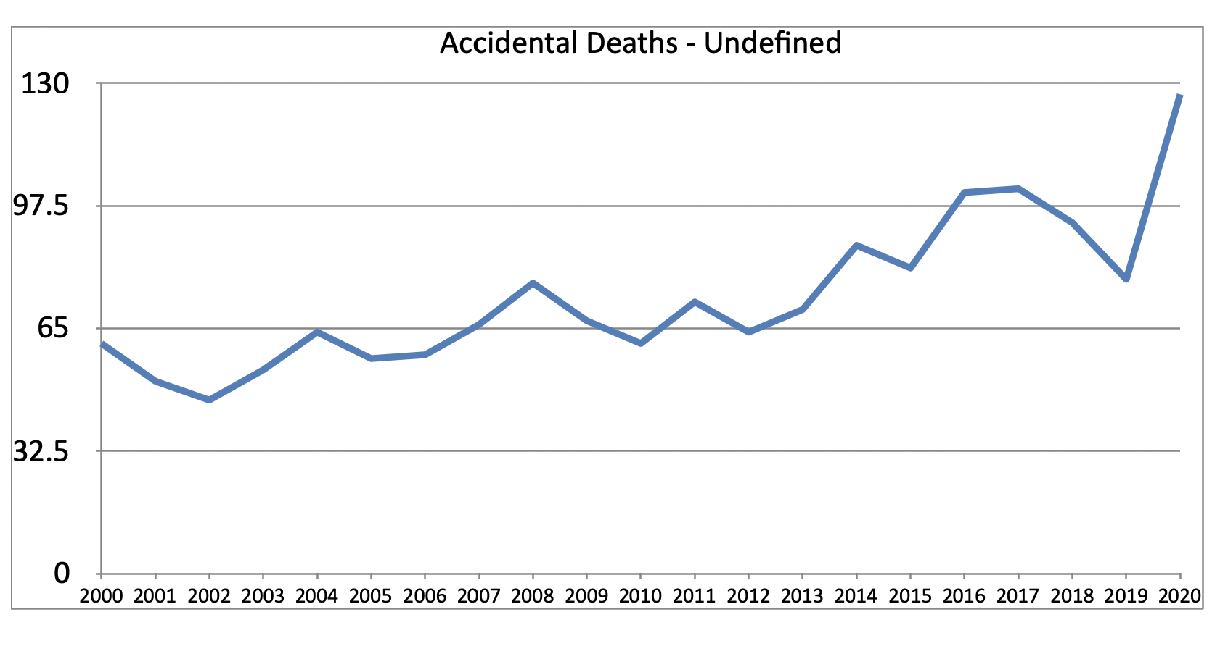
IMPACT OF SCOTTISH FATALITIES INVESTIGATION UNIT ON ACCIDENT COMPREHENSION
SFIU Instigated
Notes:
In conjunction with a lack of understanding of drivers for homicide, we are seeing that the number of accidents where the cause of death is unascertained is on the increase. Again, does this seem consistent with a greater understanding?

Slide 42
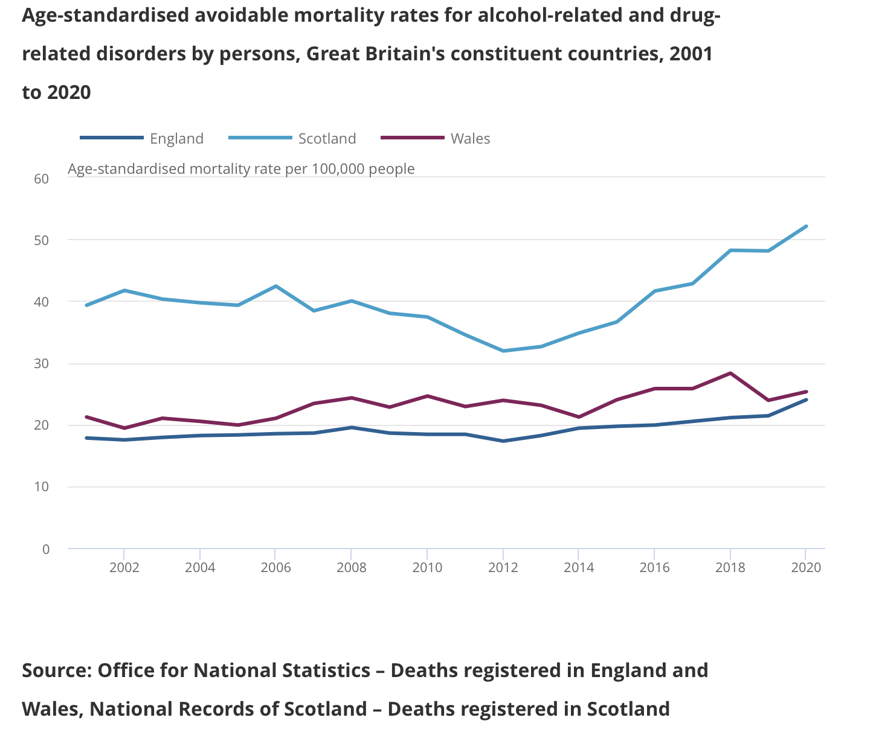
Notes:
Just as we draw to a close on the need for change, This chart shows grim reading.
It will stay like this unless we accept we have to change at the most fundamental level and join the 21st Century.

Slide 43
Another Way Forward

Slide 44
The Role of COPFS
Inspectorate of Prosecution in Scotland Report - 2016
While the number of deaths reported to COPFS has reduced in the last three years, there has been a significant increase in the proportion of deaths requiring investigation. This reflects:
An evolution in the public’s attitude to death, with a greater expectation of being involved in all important decisions regarding relatives and, in obtaining more information on the circumstances of the death;
Against this background, the number of FAIs held is extremely low, representing
0.7% of all deaths investigated.
Inspectorate of Prosecution in Scotland - Thematic Review of Fatal Accident Inquiries 2016 - Page 7, Points 17 & 18
Notes:
A brief reminder
Even with an understanding that public’s attitude is changing we see FAI’s at 0.7% and this is the lowest level of public testing of in our history. Homicide is the other main vehicle where the public can assess the depth of an investigation.

Slide 45
The Role of COPFS
Inspectorate of Prosecution in Scotland - 2016
WE ALREADY KNOW WHAT IS NEEDED FOR FAMILIES
For an organisation that aspires to deliver a world leading public prosecution and deaths investigation service, the bereaved relatives' needs must be at the heart of the process; this requires a dedicated single point of contact throughout all proceedings.
Inspectorate of Prosecution in Scotland - Thematic Review of Fatal Accident Inquiries 2016 - Page 8, Point 24
THE PRIMARY PURPOSE OF COPFS IN THE CONTEXT OF SUDDEN DEATH - IS THE PROBLEM
“To ensure any criminality is discovered and where appropriate, prosecuted”
Notes:
The focus of COPFS and Police on criminality must be at the exclusion of other causes. This in itself is not the fault of the organisations but a fault of the structure. It is right that organisations focus on their primary objectives but we have a problem when that objective is such a small part of the overall profile.
Who does have responsibility for the other deaths?
How else could we do it. We need to understand that we are the only English speaking nation that behaves like us and we have issues!

Slide 46
Coroner Inquests
The Startling Difference
The Chief Coroner has set out the coroner’s two main purposes in investigating deaths:
to explain the unexplained, both for the benefit of the family and for the public at large; and
to report, where appropriate, with a view to preventing future deaths.
https://commonslibrary.parliament.uk/research-briefings/cbp-9328/
CORONERS ATTITUDE SURVEY 2020
Virtually all coroners feel they provide an important service to society (97%), have a strong personal attachment to being a member of the coroner service (89%), and are committed to doing their job as well as they possibly can (98%). These findings reflect a deep commitment to their job by virtually all coroners.
Coroners feel most valued by families in inquests they conduct (96%), court staff (92%) and coroner colleagues at their courts (90%). A majority also feel valued by the public (78%), the Chief Coroner (68%), counsel in inquests they conduct (65%) and their local authority (56%).
https://www.judiciary.uk/wp-content/uploads/2023/03/Coroner-Attitude-Survey-2020.pdf
Notes:
The rest of the English speaking nations have Coroners inquests.
Look at the focus for England/Wales. It is on preventing future deaths and for the benefit of the family.
We do not necessarily need a Coroner but we do need some kind of public vehicle to have the same purpose.
We keep hearing about progressive politics and yet so little care is actually give to those lost, other than political blame. These people and their families deserve more!

Slide 47
Another way of Doing Things
England/Wales - Coroner System
While in some respects the purpose of an inquest by the coroner mirrors that of an FAI in Scotland, we found a number of fundamental differences that precludes any meaningful comparisons between the two systems:
The coroner service is essentially a local service, run by individual local authorities;
The type of investigation that can result in an inquest in the coroner's system is much wider and include all suicides and drug and alcohol related deaths and more recently, all deaths of residents in care homes or hospitals that are subject to Deprivation of Liberty Safeguards ( DoLS), usually the elderly suffering from dementia. There are also understandable differences in scale; in 2014, for example, the coroner opened 25,889 inquests [14] compared to 34 FAIs held in Scotland;
There are some differences in the way drug deaths are categorised between Scotland and the rest of the UK. In Scotland, drug related deaths are usually registered more quickly, as the rest of the UK usually requires a coroner to certify the death after an inquest. This means that Scotland’s statistics are likely to be slightly more up-to-date.
HM Inspectorate of Prosecutions in Scotland 2016 Report
In 2020 the Coroner’s had the added responsibility to look at the circumstance of death and not only cause of death.
While a Coroner system may not be what we want, we must look at the significant number of inquests being held in England and Wales and ask if we are doing enough?
Notes:
This brief consideration of what takes place down South must be some for of reference to the disparity in our approach. As stated, we clearly do not need to copy the Coroner’s system but the scale of investigation and family participation from outside the Prosecution system is significant.
The importance of understanding the circumstances of death and the possible elimination of the cause must be broader than what is considered today.

Slide 48
DEATH INVESTIGATION, CORONERS’ INQUESTS AND THE RIGHTS OF THE BEREAVED
Irish Council of Civil Liberties - 2020
From the outset, ICCL believed that human rights improvements in the system of inquests is possible – and we have been impressed by the radical reform of the inquest system in the United Kingdom over recent decades.
In 2019 31,134 deaths were registered in Ireland.² 17,822 were referred to local coroners of which 12,098 were subject to a coroner’s report, a further 3,499 to a report and post- mortem and 2,225 to a report, post-mortem and inquest.twenty-six counties there are thirty-nine coronial districts.⁴
Compared to the 54 FAI’s in Scotland in 2019
Notes:
I know that we have at times an aversion to learning from England so I thought it worthily to include these comments from the Irish Council of Civil Liberties.
They like the English system, so not just me. An old adage from my working days was that we needed to learn to steal good ideas shamelessly.
We see here that even Ireland has 2225 inquests compared to our 34 FAI’s.
AGAIN, WE DO NOT CARE ABOUT SUDDEN DEATH BUT NEED TO.

Slide 49
A Fundamental Expectation
How Close To Expectation Are We?
For an organisation that aspires to deliver a world leading public prosecution and deaths investigation service, the bereaved relatives' needs must be at the heart of the process; this requires a dedicated single point of contact throughout all proceedings. (HMIP - 2016)
In fact, the Court has recently underlined that Article 2 also comes into play in situations where the person concerned was the victim of an activity or conduct, whether public or private, which by its nature put his or her life at real and imminent risk and he or she has suffered injuries that appear life-threatening as they occur, even though he or she ultimately survived - ECHR AUG 2022
Article 2 § 1 enjoins the State not only to refrain from the intentional and unlawful taking of life but also to take appropriate steps to safeguard the lives of those within its jurisdiction (Centre for Legal Resources on behalf of Valentin Câmpeanu v. Romania [GC], 2014, § 130). In broad terms, this positive obligation has two aspects: (a) the duty to provide a regulatory framework; and (b) the obligation to take preventive operational measures.
Investigation Expectations - They must be effective and thereby, independent, prompt and transparent.
Simply put, we need a system that publicly reviews all sudden deaths with the aim to prevent
future cases with the families at the heart of the investigation and findings
Notes:
We must see that it is not only principled but morally required that we need to change but it is essential if we want to save lives. There is a huge opportunity out there to affect change but we need to remove the blinkers to the historic institutional behaviours we have.

Slide 50
The Initial problem of Structural Success
Counter-intuitive Success
Thorough Investigation
Increase in recognised Crime
Perceived Deterioration of Metrics
Competent Investigation
Investigation Integrity
Initial impact of a thorough effective investigations - True cause of death identified
Who has the strength or desire to face this honesty?
Notes:
A bi-product of a thorough investigation system is that crimes/failings are usually found. In the short term that gives the impression things are getting worse but in reality we are gaining greater insight.
It takes strength and preparedness to take this step. The real reading of success or failure must come from a reduction in the total number of sudden deaths.
If this change is grasped, the shift in expected numbers must be communicated to prepare public. If this is not done in a timely manner, the next government will be trapped into hiding true numbers in fear of political exploitation.

Slide 51
Scotland Sudden Death Escalation In Crisis
KEY LEARNINGS/TAKEAWAYS
Scotland does not care about sudden death.
No one is accountable for improving sudden death
The crisis extends beyond drugs
FAI’s are a blindspot - a misunderstood and misleading artifact
Changing FAI’s will change little
No Substantive Learning Opportunities in Place
Where there is accountability, there is improvement
Opportunity exists to change at relatively low cost
Recognition of family needs and involvement
A need to think differently
Increased responsiveness to change is a simple step
Notes:
This is the summary of my findings and hopefully help shape the understanding and any discussion on the upcoming information in subsequent slides. This is not the time to get into the details but really absorb the significance of what I am stating.
The primary areas of focus within the analysis in these slides show that we are seriously failing on the areas that when combined show how much contempt we have for true social justice. For all the rhetoric over many years from all political parties we have clearly being misled on actual intent. Each party, for completely different reasons, thrive on this
crisis.
If we begin to care, we can maybe actually make changes that are meaningful.
Clearly all of this is my own opinion.

Slide 52
A Fundamental Expectation
Simply put, we need a system that facilitates the potential to publicly review all sudden deaths with the aim to prevent future cases, with the families at the heart of the investigation and findings.
Action Required
We have a crisis and change is needed now.
Families need to be involved now.
There has to be greater public openness now
There is a need for greater use of dynamic statistics in reviewing data
There needs to be greater action orientated to containing/stopping increasing numbers
There need to be an overhaul of investigation structure - long-term

